Slide 1
ECEG-5193: Algorithm Analysis and Design
Introduction

Slide 2
Text Book
References:
Cormen, Leiserson, Rivest : Introduction to Algorithms
Robert Sedgwick, Algorithms in C/C++
Aho, Hopcroft, Ullman: The Design & Analysis of Computer Algorithms
J. Kleinberg and E. Tardos, Algorithm design, Addison-Wesley, 2005.

Slide 3
Why You have to take this course
Apply learned techniques to solve various problems
Have a sense of complexities of various problems in different domains
Find excuses if you cannot solve a problem?

Slide 4
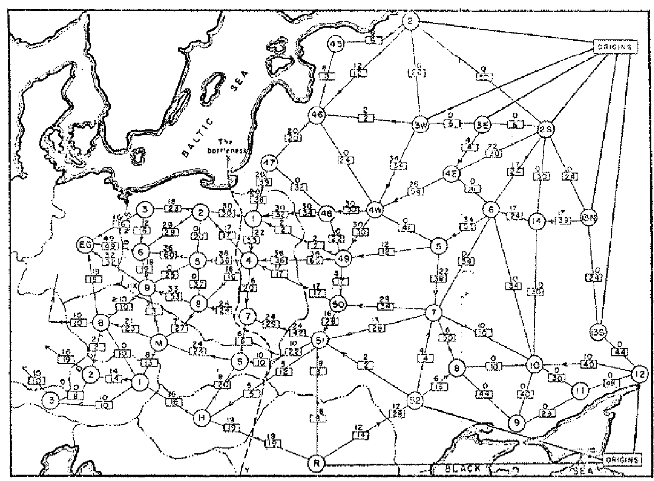
Find a shortest path from station A to station B.
B
need serious thinking to get a correct algorithm.
A

Slide 5
Boss assigns task: A Real-Time Driver’s Direction System
Given:
Electronic map (stored on a computer),
the position of your car (provided by GPS), and
the destination,
Design a system
that tells you turn left or right 40 meters before according to the shortest path.
Your answer:
Um? Tell me what to code.
With more sophisticated software engineering systems, the demand for mundane programmers will diminish.

Slide 6
Your answer:
I learned this great algorithm that will work.
Soon all known algorithms will be available in libraries.

Slide 7
Original Thinking
Your answer: I can develop a new algorithm for you.
Great thinkers will always be needed.

Slide 8
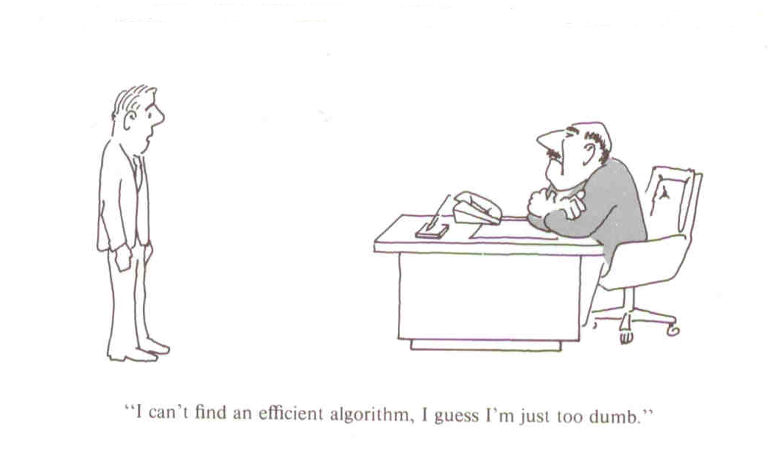

Slide 9
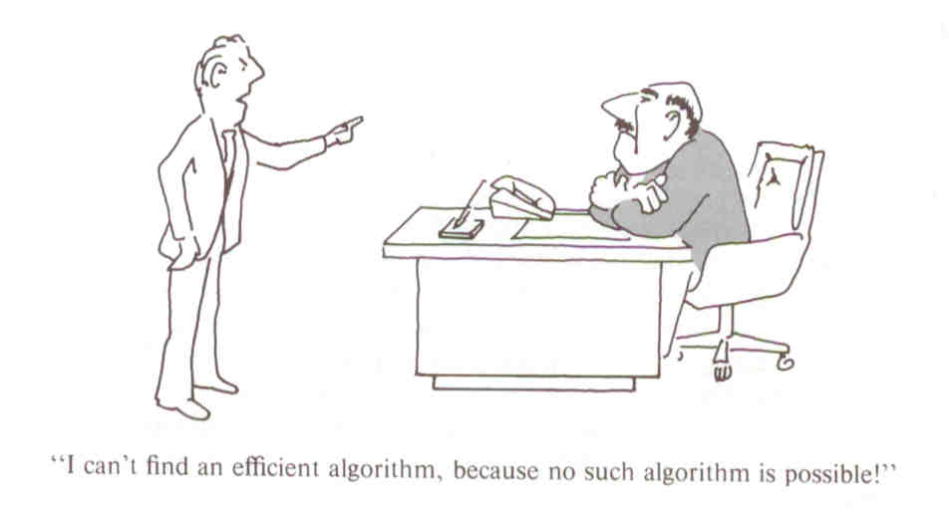

Slide 10
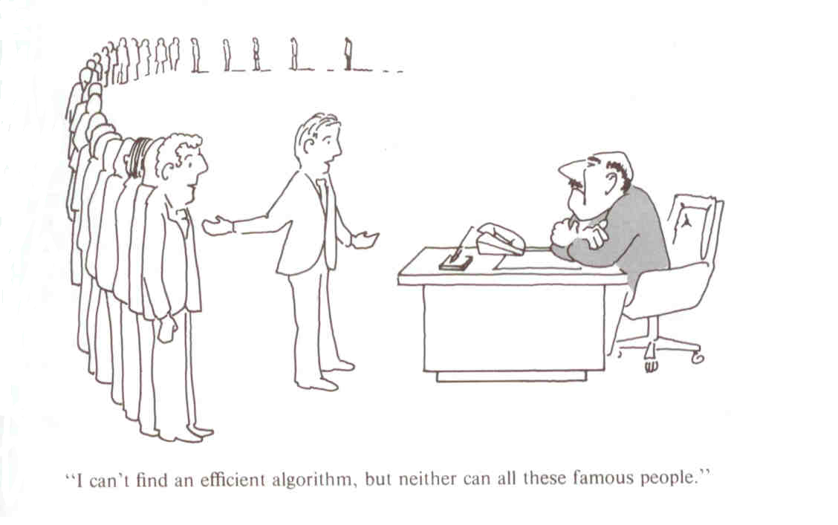

Slide 11
A Joke:
The boss wants to produce programs to solve the following two problems
Euler circuit problem:
given a graph G, find a way to go through each edge exactly once.
Hamilton circuit problem:
given a graph G, find a way to go through each vertex exactly once.
The two problems seem to be very similar.
Person A takes the first problem and person B takes the second.
Outcome:
Person A quickly completes the program, whereas person B works 24 hours per day and is fired after a few months.

Slide 12
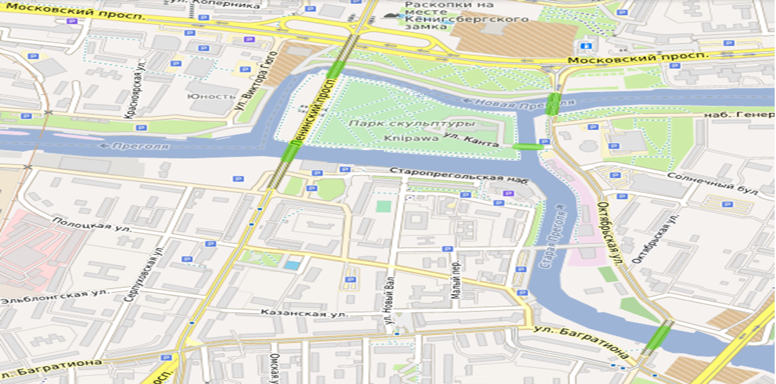
Euler Circuit: Present (Konigsberg) Kaliningrad bridge

Slide 13
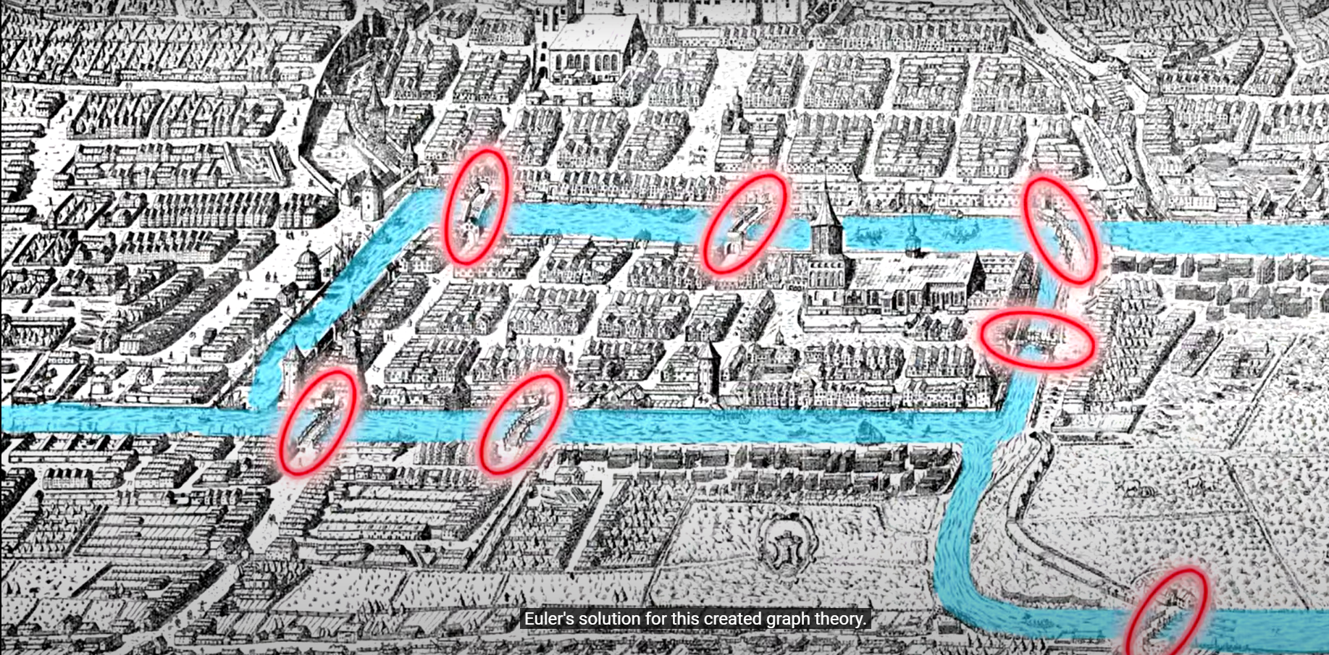
Euler Circuit: The original Konigsberg bridge

Slide 14
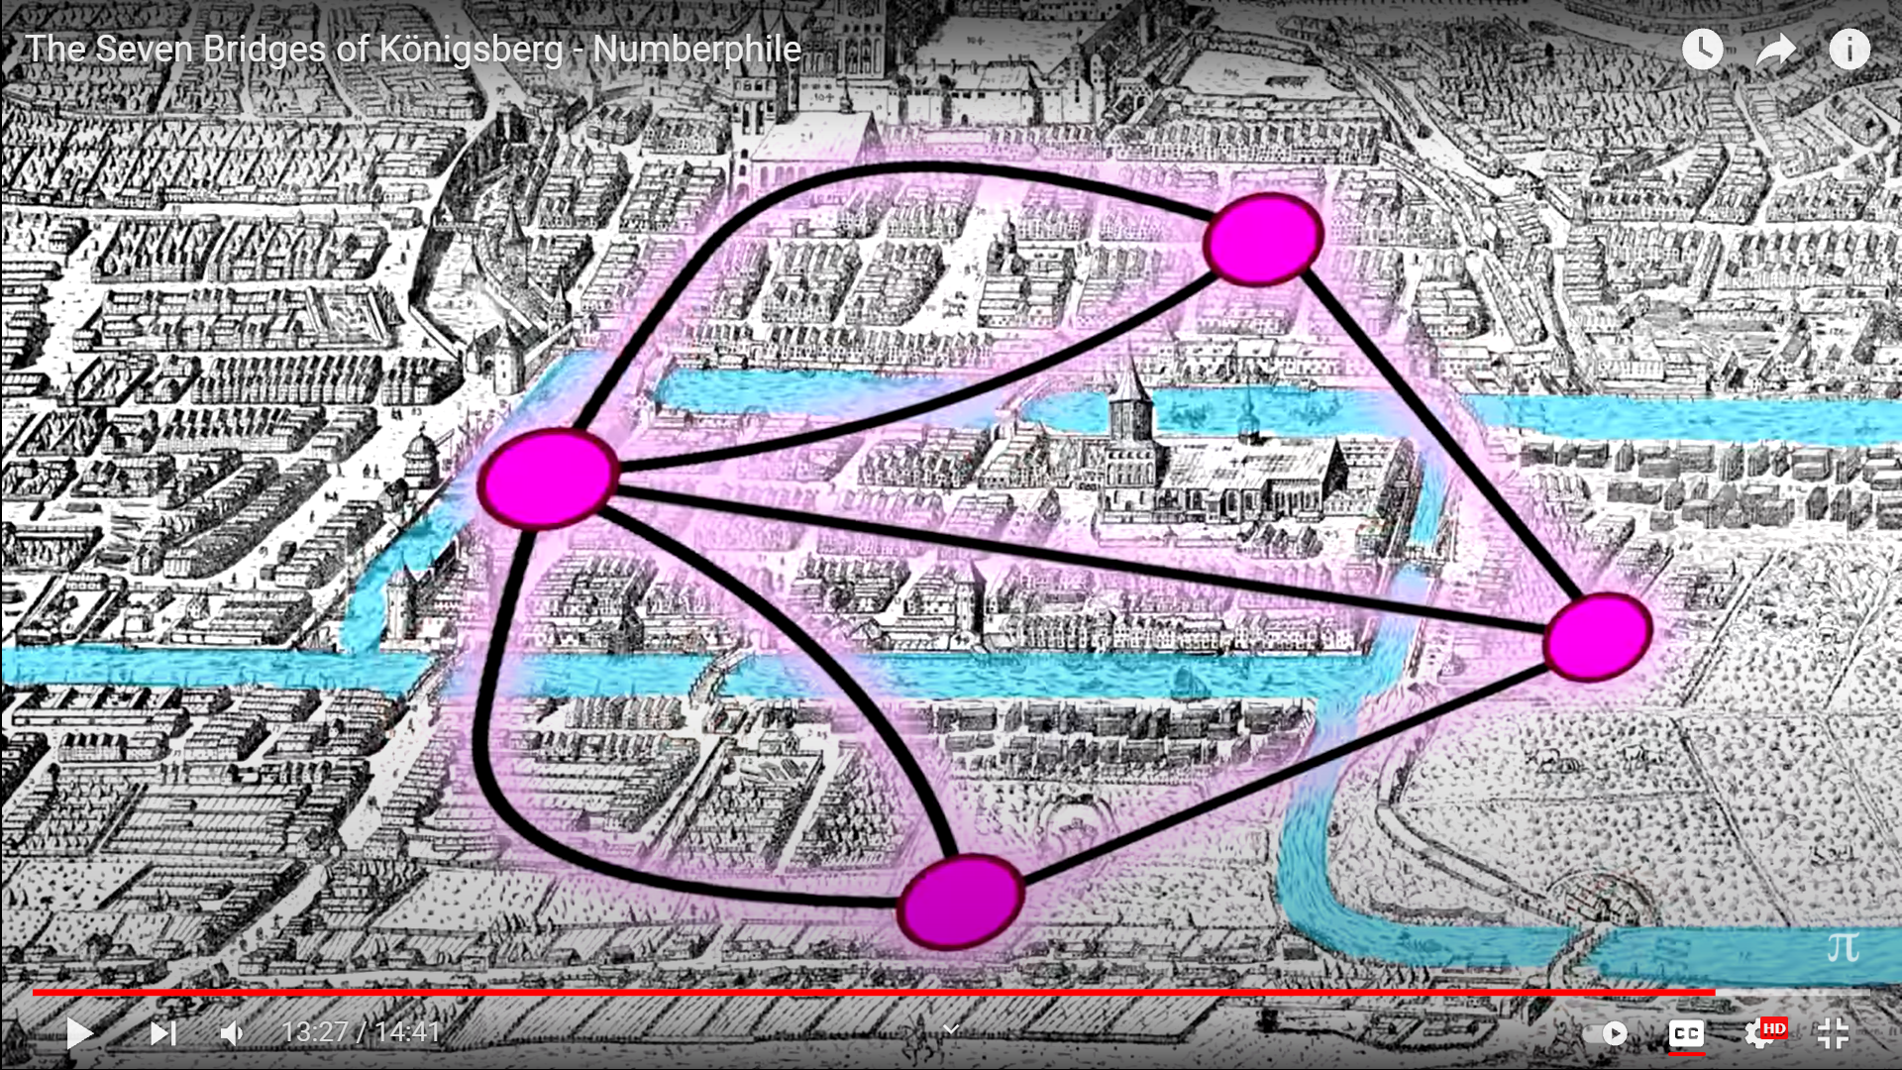
Euler Circuit: The original Konigsberg bridge

Slide 15
A joke (continued):
Why? no body in the company has taken a course on algorithms
Explanation:
Euler circuit problem can be easily solved in polynomial time.
Hamilton circuit problem is proved to be NP-hard.
So far, no body in the world can give a polynomial time algorithm for a NP-hard problem.
Conjecture: there does not exist polynomial time algorithm for this problem.

Slide 16
On this Course …
prove the correctness and analyze the running time of the basic algorithms for those classic problems in various domains;
apply the algorithms and design techniques to solve problems;
analyze the complexities of various problems in different domains.
Course work, Lab, Tutorials, Assignments and Exam.
1
2
3

Slide 17
How to Learn
1
Attend every lecture tutorial and lab
Try to go with me when I am talking
Ask questions immediately
Try to fix all problems during tutorial/lab/lecture
Ask others.
2
3
4
5

Slide 18
Algorithms
A sequence of unambiguous instructions for solving a problem, i.e. for obtaining the required output for any legitimate input in a finite amount of time
Any well-defined computational procedure takes some value, or set of values, as input and produces some value, or set of values, as output.
A sequence of computational steps that transform the input into output.
A sequence of computational steps for solving a well-specified computational problem.
- Can be represented various forms
- Unambiguity/clearness
- Effectiveness
- Finiteness/termination
- Correctness

Slide 19
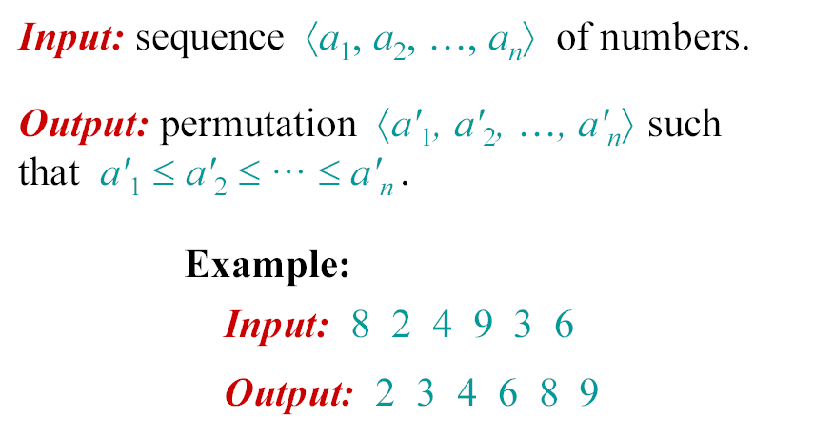
Example of well-specified problem: Sorting

Slide 20
Descriptions of Algorithms
Flow chart
Pseudo-code
Programs
…
The purpose:
Allow a well-trained programmer to write a program to solve the computational problem.
Any body who can talk about algorithm MUST have basic programming skills

Slide 21
Important points
Non-ambiguity
Range of inputs
The same algorithm can be represented in different ways
Several algorithms for solving the same problem
Finiteness/termination
Effectiveness
Correctness

Slide 22

The Process of Design an Algorithm
Formulating the problem
What are the problem objects?
What are the operations applied to the objects?
How the objects would be represented?
How the operations would be implemented?
Design the algorithm
- Build a computational model of the solving process
- list the “precise” steps. (an expert can translate the algorithm into a computer program.)
Analyze the algorithm
Math formula
- Prove correctness: Correct output for every legitimate input in finite time.
Induction
- Efficiency: time and space
- Generality : range of inputs, special cases,
- Optimality : no other algorithm can do better
Simplicity

Slide 23
Important Problems Types
Sorting
Searching
String processing
Graph problems
Combinatorial problems
Geometric problems
Numerical problems

Slide 24
Conclusion
Algorithm classification
By types of problems
By design technique
Design techniques
a general approach to solving problems

Slide 25
What We Cover
Algorithm analysis basics
Recurrences,
Analysis of Sorting & searching algorithms,
Algorithm design techniques,
Graph Algorithms,
String Processing Algorithms,
Problem complexity and type,
Introduction to parallel computation.
1
5
2
6
3
7
4
8

Slide 26
Recurrences
Analysis of Sorting & searching algorithms,
Algorithm design techniques,
Graph Algorithms
String Processing Algorithms
Problem complexity and type
Introduction to parallel computation
Brute force
Divide and conquer
Greedy approach
Dynamic programming
Iterative improvement
Backtracking
Branch and bound
amortized analysis.
Depth-first search
Recurrences
Complexity of problems
Connected components
Topological sort
Shortest paths
Tractable and intractable problems
Master Method
Algorithm analysis Basics
The running time of a program
Big-Oh, Omega and Theta notations
Lower bounds
Worst and average case analysis
Time and space trade-offs
Analysis of Simple Algorithms: sorting, searching
Analysis of Advanced Algorithms: advanced trees, heaps, hash tables

